Slide 1
Cells & Enzymes
Present in
all living cells
Converts substrates
into products
Made of protein
Enzymes
Biological catalysts
Increase the rate of
chemical reactions
Remain unchanged
by chemical reaction

Slide 2
HISTORY of Enzymes
As early as the late 1700s and early 1800s, the digestion of meat by stomach secretions and the conversion of starch to sugars by plant extracts and saliva were known. However, the mechanism by which this occurred had not been identified.

Slide 3
In the 19th century, when studying the fermentation of sugar to alcohol by yeast, Louis Pasteur came to the conclusion that this fermentation was catalyzed by a vital force contained within the yeast cells called "ferments", which were thought to function only within living organisms. He wrote that "alcoholic fermentation is an act correlated with the life and organization of the yeast cells, not with the death or putrefaction of the cells.

Slide 4
In 1878 German physiologist Wilhelm Kühne (1837–1900) first used the term enzyme, which comes from Greek ενζυμον "in leaven", to describe this process. The word enzyme was used later to refer to nonliving substances such as pepsin, and the word ferment used to refer to chemical activity produced by living organisms.
In 1897 Eduard Buchner began to study the ability of yeast extracts that lacked any living yeast cells to ferment sugar. In a series of experiments at the University of Berlin, he found that the sugar was fermented even when there were no living yeast cells in the mixture.
He named the enzyme that brought about the fermentation of sucrose "zymase". In 1907 he received the Nobel Prize in Chemistry“ for his biochemical research and his discovery of cell-free fermentation".

Slide 5
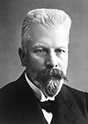
 | The Nobel Prize in Chemistry 1907
Eduard Buchner
Germany
Landwirtschaftliche Hochschule (Agricultural College) Berlin, Germany
b. 1860, d. 1917.
"for his biochemical researches and his discovery of cell-free fermentation"

Slide 6
Enzyme activity can be affected by other molecules.
Inhibitors are molecules that decrease enzyme activity.
activators are molecules that increase activity. Many drugs and poisons are enzyme inhibitors.
Activity is also affected by temperature, chemical environment (e.g. pH).

Slide 7
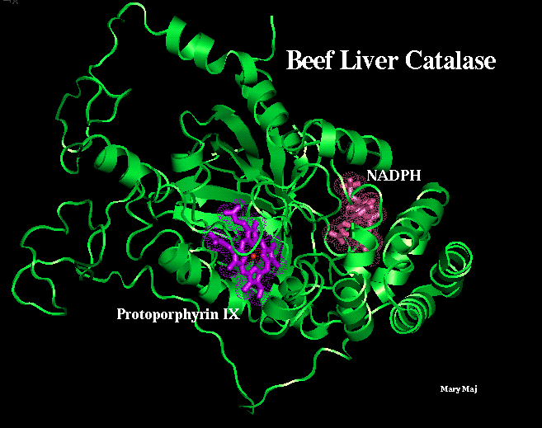
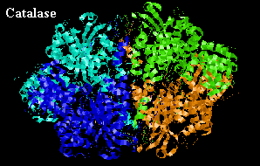
Rate enhancement
2 H₂O₂ → 2 H₂O + O₂
Fe³⁺ →1000 fold
Hemoglobin → 1 ,000,000 fold
Catalase → 1 ,000,000,000 fold
200,000 catalytic events/second/subunit
(near the diffusion-controlled limit).
The reaction is sped up by a billion fold!
(a prosthetic group)
Active site
(tetramers)

Slide 8
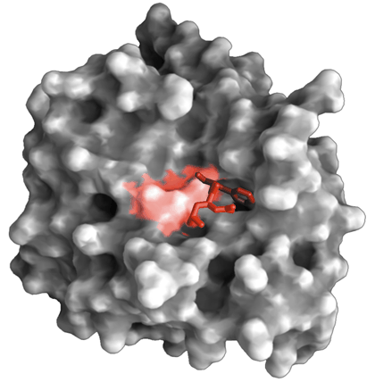
Each enzyme has at least one active site

Slide 9
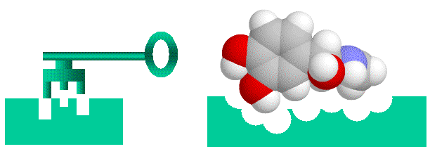
Lock & Key Hypothesis
An enzyme only acts on one type of substance, or substrate.
Therefore, the enzyme is said to be SPECIFIC to its one substrate.
The shape of the active site (binding site) of the enzyme, matches the shape of the substrate. Allowing the two molecules to bind during the chemical reaction.
This theory of enzyme action is called the ‘lock-and-key’ hypothesis.

Slide 10
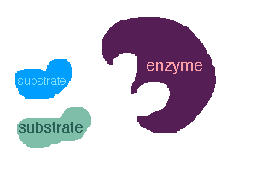

Slide 11
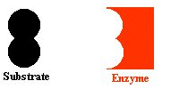

Slide 12
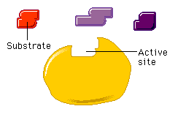
MOVIE

Slide 13
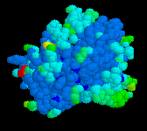

Slide 14
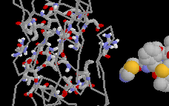

Slide 15
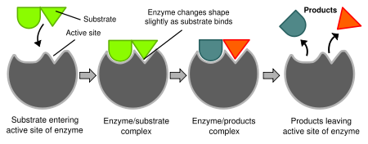
Induced fit model
Diagrams to show the induced fit hypothesis of enzyme action.

Slide 16
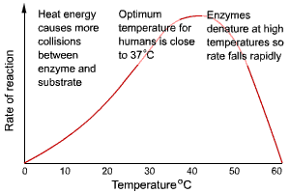
2.5 Effect of High Temperature
What happens to the activity of an enzyme at high temperatures?

Slide 17
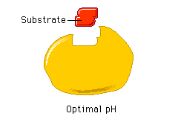
Effect of pH on enzymes
When the pH changes outwith optimal conditions, the shape of the active site of the enzyme alters and the enzyme is denatured.
Movie

Slide 18
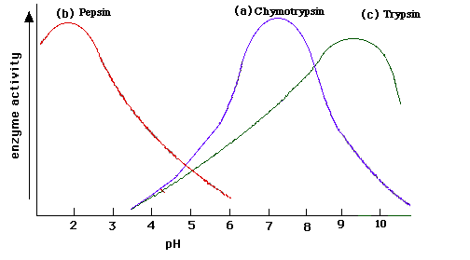
Effect of pH on enzyme activity
Most enzymes work best at a pH close to neutral (pH7), but there are some exceptions. Pepsin, an enzyme found in the stomach, has an optimum pH of 2.

Slide 19
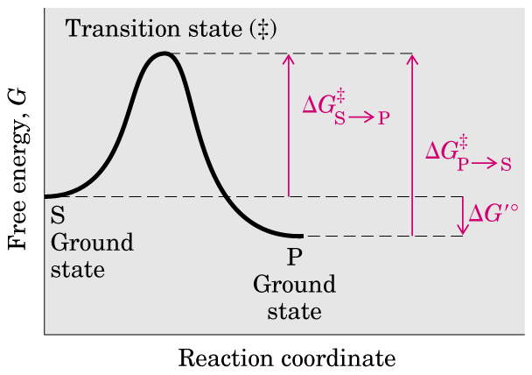

for
ΔG°
o
Notes:
o

Slide 20
An enzyme provides an alternative pathway for the conversion of the substrates to the products.

Slide 21
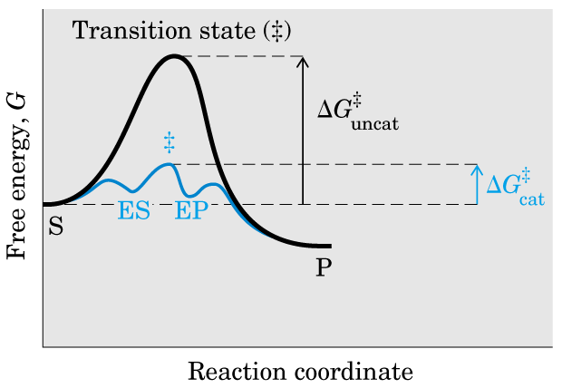
Enzymes make the rate constants
larger and only catalyze reactions
that are thermodynamically favorable.
An enzyme provides an alternative pathway for the
conversion of the substrates to the products, thus
lowers the activation energy and speeds up the reaction.

Slide 22
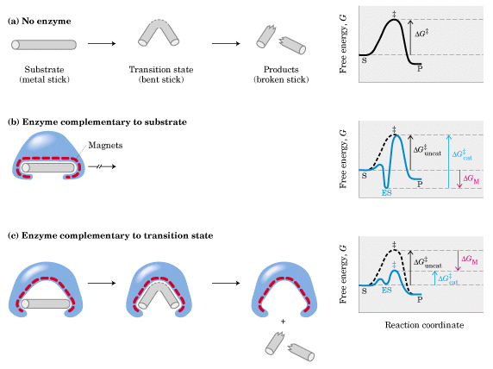
An effective enzyme must
have its active site
complementary to the
transition state of the reaction.
Activation energy increases!
ES
E-transition state
E + P

Slide 23
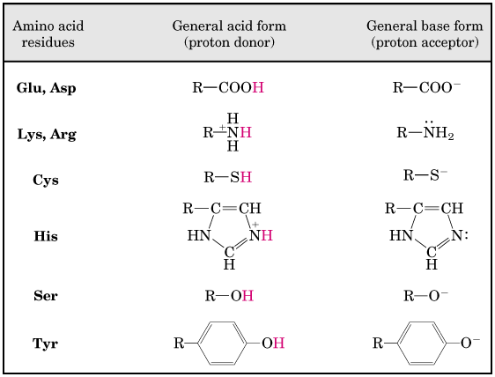
Side chains of many amino acid residues can act as general acid-base

Slide 24
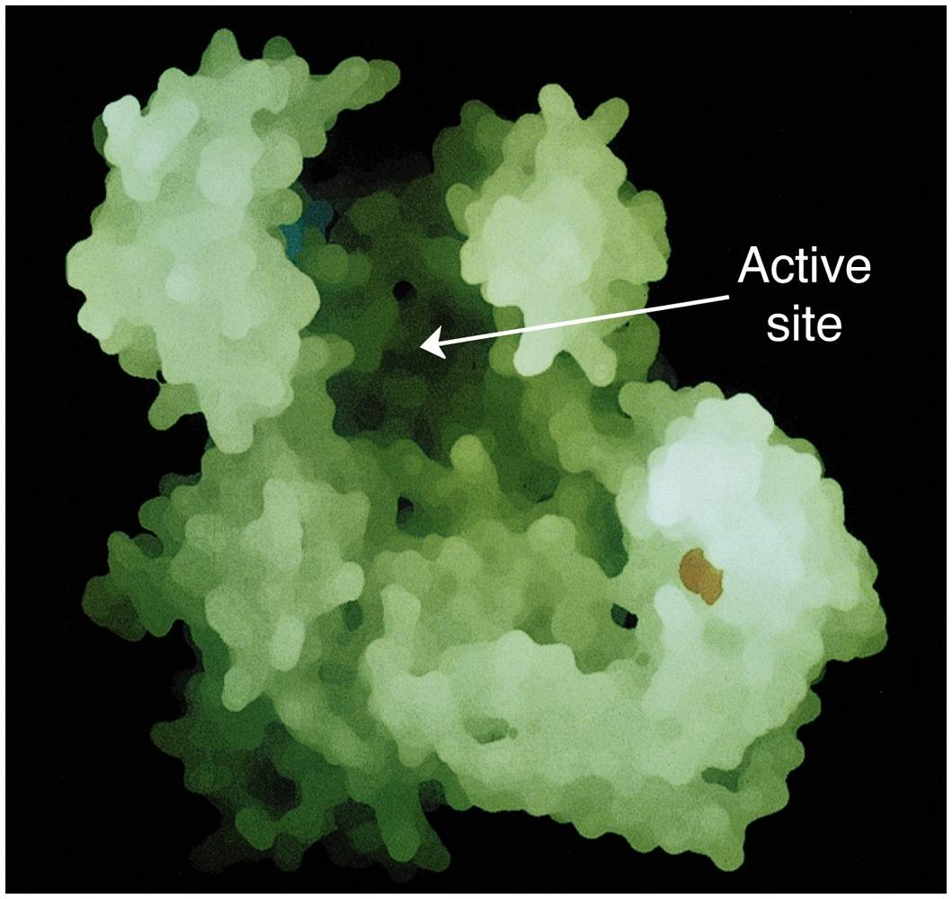
Enzyme active sites
Active sites:
Usually form a cleft or pocket.
Substrates are bound by multiple weak interactions.

Slide 25
Enzymes are the most remarkable and specialized biological catalysts
An enzyme catalyzes a chemical reaction at a specifically structured active site, being often within the confine of a pocket on the enzyme.
Enzymes have extraordinary catalytic power, often far greater than those non-biological catalysts.
Enzymes often have a high degree of specificity for their substrates.
Enzymes are often regulated.
Enzymes usually work under very mild conditions of temperature and pH.
The substance acted on by an enzyme is called a substrate, which binds to the active site of an enzyme in a complementary manner.

Slide 26
Many enzymes need non-protein cofactors to help in catalysis
Cosubstrates?
The cofactors can be inorganic ions or coenzymes (complex organic or metallo-organic molecules).
Some cofactors bind to the enzyme protein very tightly (non-covalently or covalently), they are thus called prosthetic groups
.
Only the combination of an apoenzyme with its cofactor (a holoenzyme) is operative (a holoenzyme also refers to the assembled form of a multiple subunit protein).
Coenzymes usually function as transient carriers of specific function groups.
Vitamins (organic nutrients required in small amount in the diet) have been found to often act as precursors of coenzymes.

Slide 27
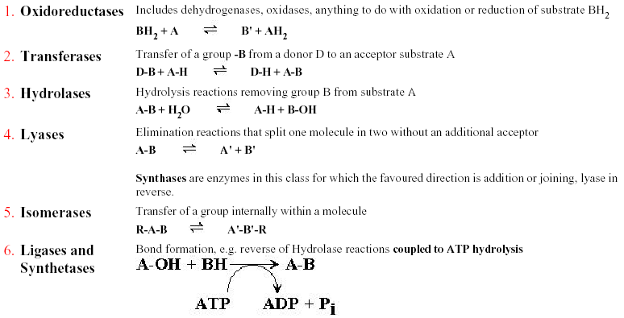
Lactate
dehydrogenase
Transfer electrons (hydride ions or H atoms);
play a major role in energy metabolism.
e.g., the transfer of a phosphoryl group
from ATP to many different acceptors.
NMP kinase
Chymotrypsin
the transfer of functional groups to water.
These are direct bond breaking reactions without being attacked by another reactant such as H₂O.
Fumarase
Triose phosphate
isomerase
In chemical terms, they would be described as
elimination and addition reactions.
Leading to the formation of C-C, C-S,
C-O, C-N bonds.
Aminoacyl-tRNA synthetase

Slide 28
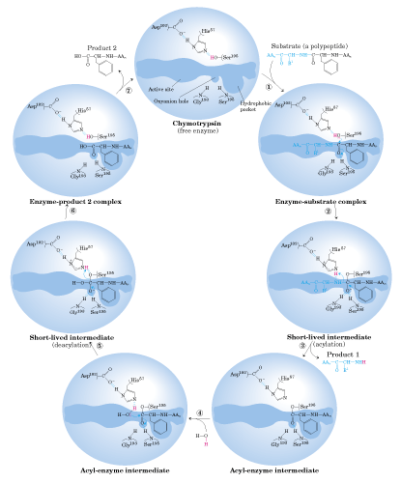
2nd product
1st substrate
E
EP₂
ES
The proposed complete
catalytic cycle of
chymotrypsin
(rate enhancement: 10⁹)
A Ping-Pong Mechanism
1st product
E’S₂
Deacylation
phase
Acyl-E
Acylation
phase
2nd substrate

Slide 29
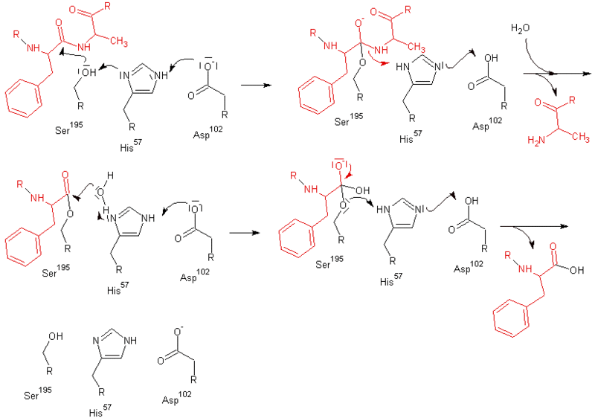

Slide 30
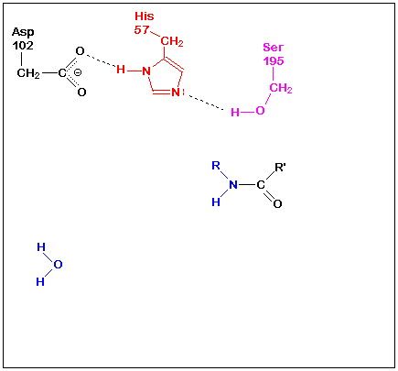
A dynamic process for chymotrypsin catalysis:
A Ping Pang mechanism.
Importance of the
residues was
exmined by
site-directed
mutagenesis:
The Ser and His
residues are far
more important
than the Asp
residue!

